Slide 1
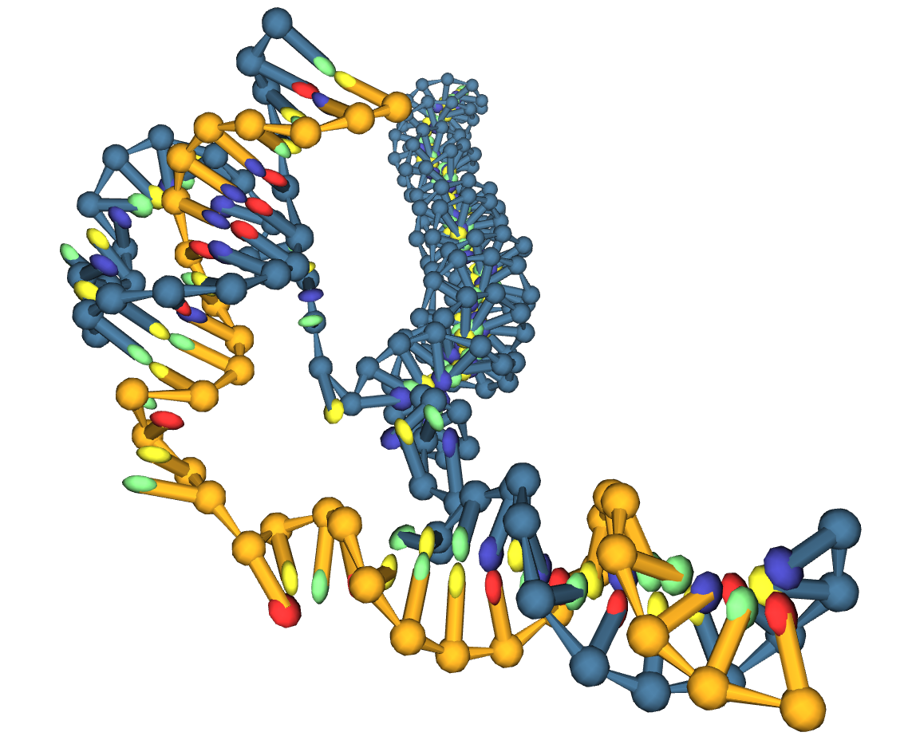

Coarse-Grain Modelling of
DNA Triplet Repeat Slip-out Migration
X THE PLACE OF USEFUL LEARNING
Lewis M Russell | SN: 201817988
Supervisor | Dr Oliver Henrich
Date | 16/11/2022

Slide 2
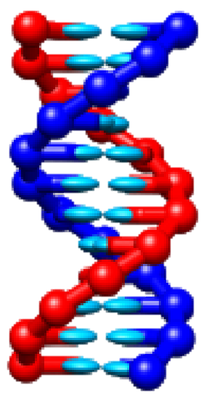
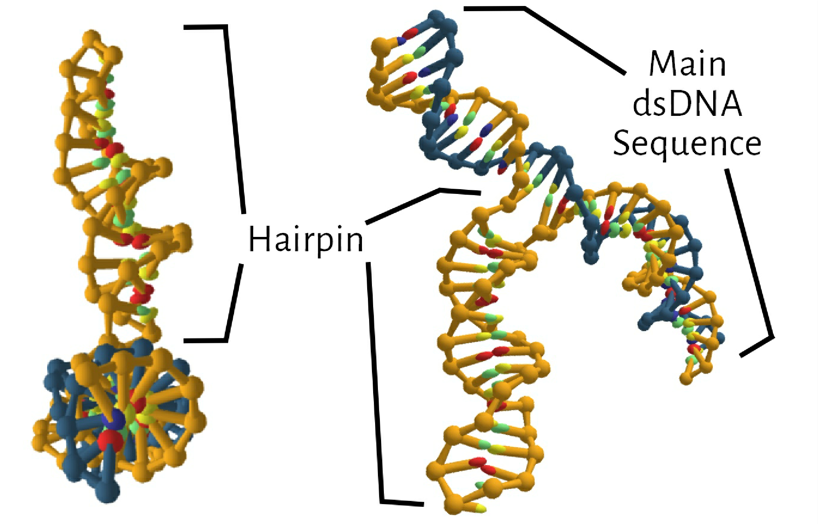
Motivation for Triplet Repeat Slip-Out Research
Triplet Repeat -> CAGCAG….. CTGCTG…..
Attributed to Repeat-Expansion-Diseases* (REDs):
Huntington Disease (HD) – 1993
Spinocerebellar Ataxia (SCA) – 1993
Myotonic Dystrophy (DM) – 1992
No therapy
Little Understanding of Repeat-Sequence Mechanics
RED | Genetic Visualisation
Hairpins contain undesirable repeat sequences of DNA bases, in our research case, CAG and CTG.
*Khristich, Mirkin.. J Biol Chem. 2020 Mar 27;295(13):4134-4170. doi: 10.1074/jbc.REV119.007678. Epub 2020 Feb 14.

Slide 3
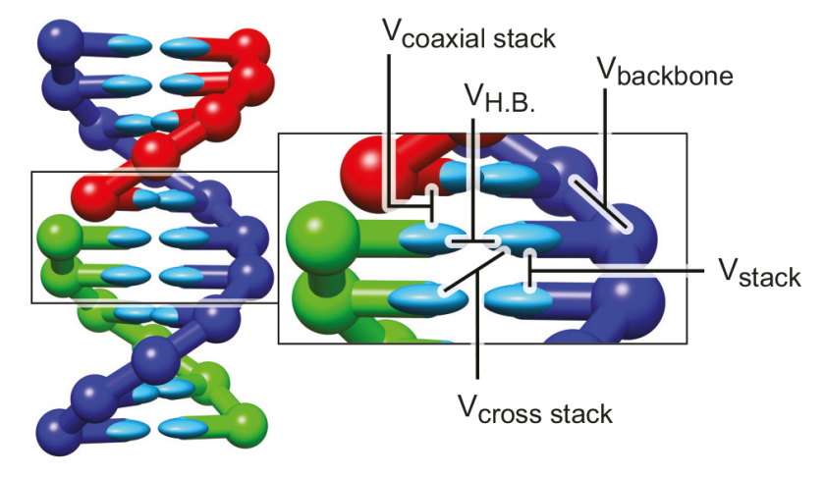
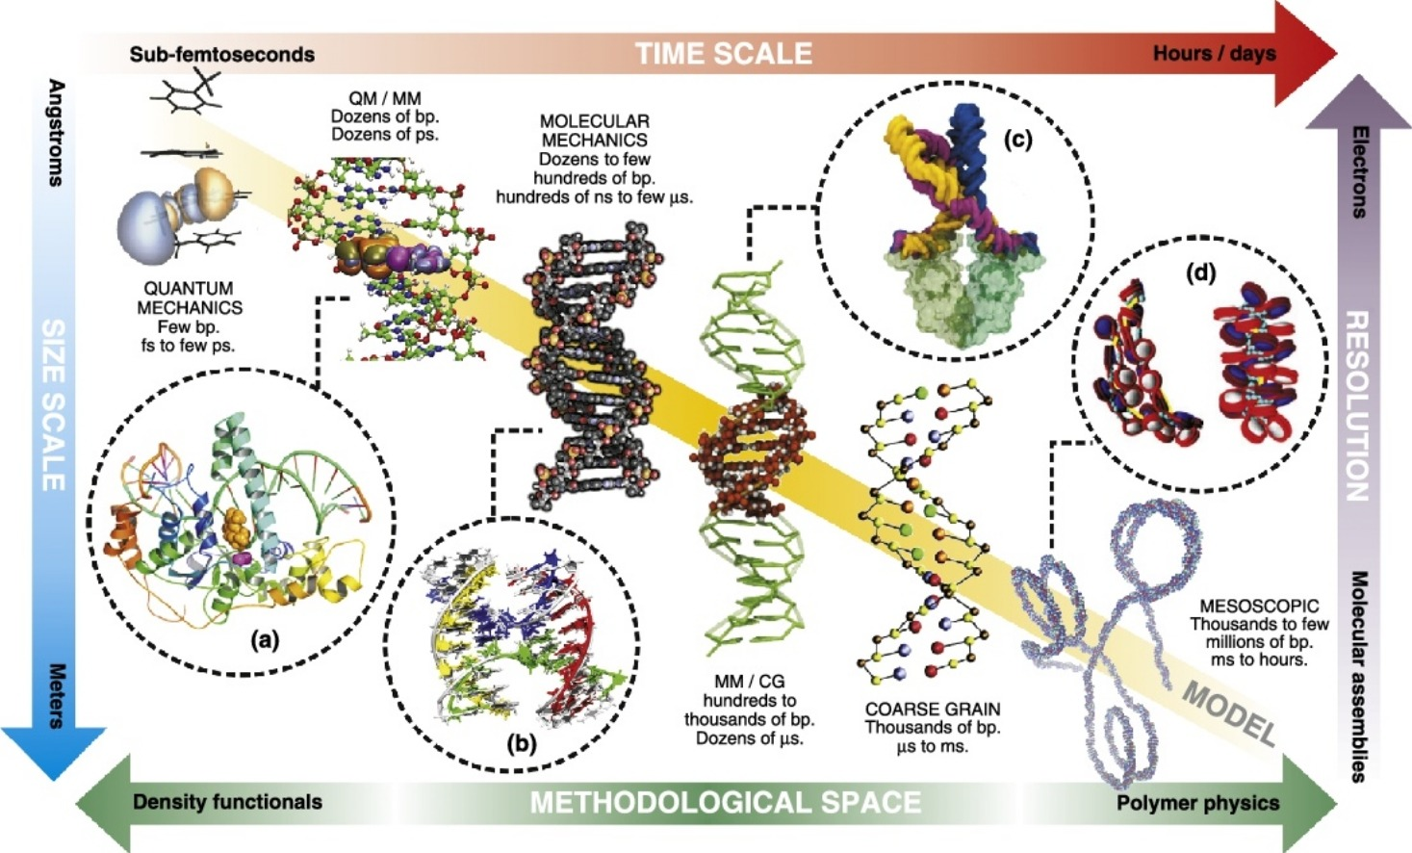
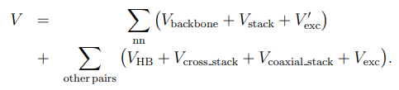
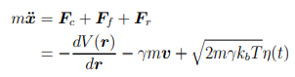
Coarse-Grain Modelling
†
*
Potentials
Equ. of Motion
F_{c} | Potential-Dependent Conservative Force
F_{f} | Velocity-Dependent Frictional Force
F_{r} | Temperature-Dependent Random Force
oxDNA / CG-DNA
*Figure From: D Dans, Walther, G´omez, and Orozco. Current opinion in structural biology, 37:29–45, 2016.
†Figure From: Sulc, Romano, Ouldridge, Rovigatti, Doye, and Louis. The Journal of chemical physics, 137(13):135101, 2012.
oxDNA | Our Molecular Dynamics Model

Slide 4
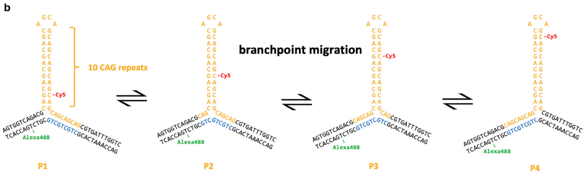
Rationale for Additional Modelling
Hairpin Shown in Yellow
Paper* Investigates Hairpins:
CAG_10
CAG_40
CTG_30
Hairpin Migrates Along Main dsDNA Strand
Main Finding | Triplet-Repeats Slip in and out of Main dsDNA Sequence -> branchpoint migration
Regarding CG-Modelling, the Paper vs Project:
Implement New “Metadynamics” Method
Switch Directionality | 5’_GAC_3’ -> 5’_CAG_3’
Model CAG_40 and CTG_30 Hairpin Dynamics and Energies
*Bianco, Hu, Henrich, Magennis. Biophysical Reports, Volume 2, Issue 3, 2022, 100070, ISSN 2667-0747, https://doi.org/10.1016/j.bpr.2022.100070.

Slide 5
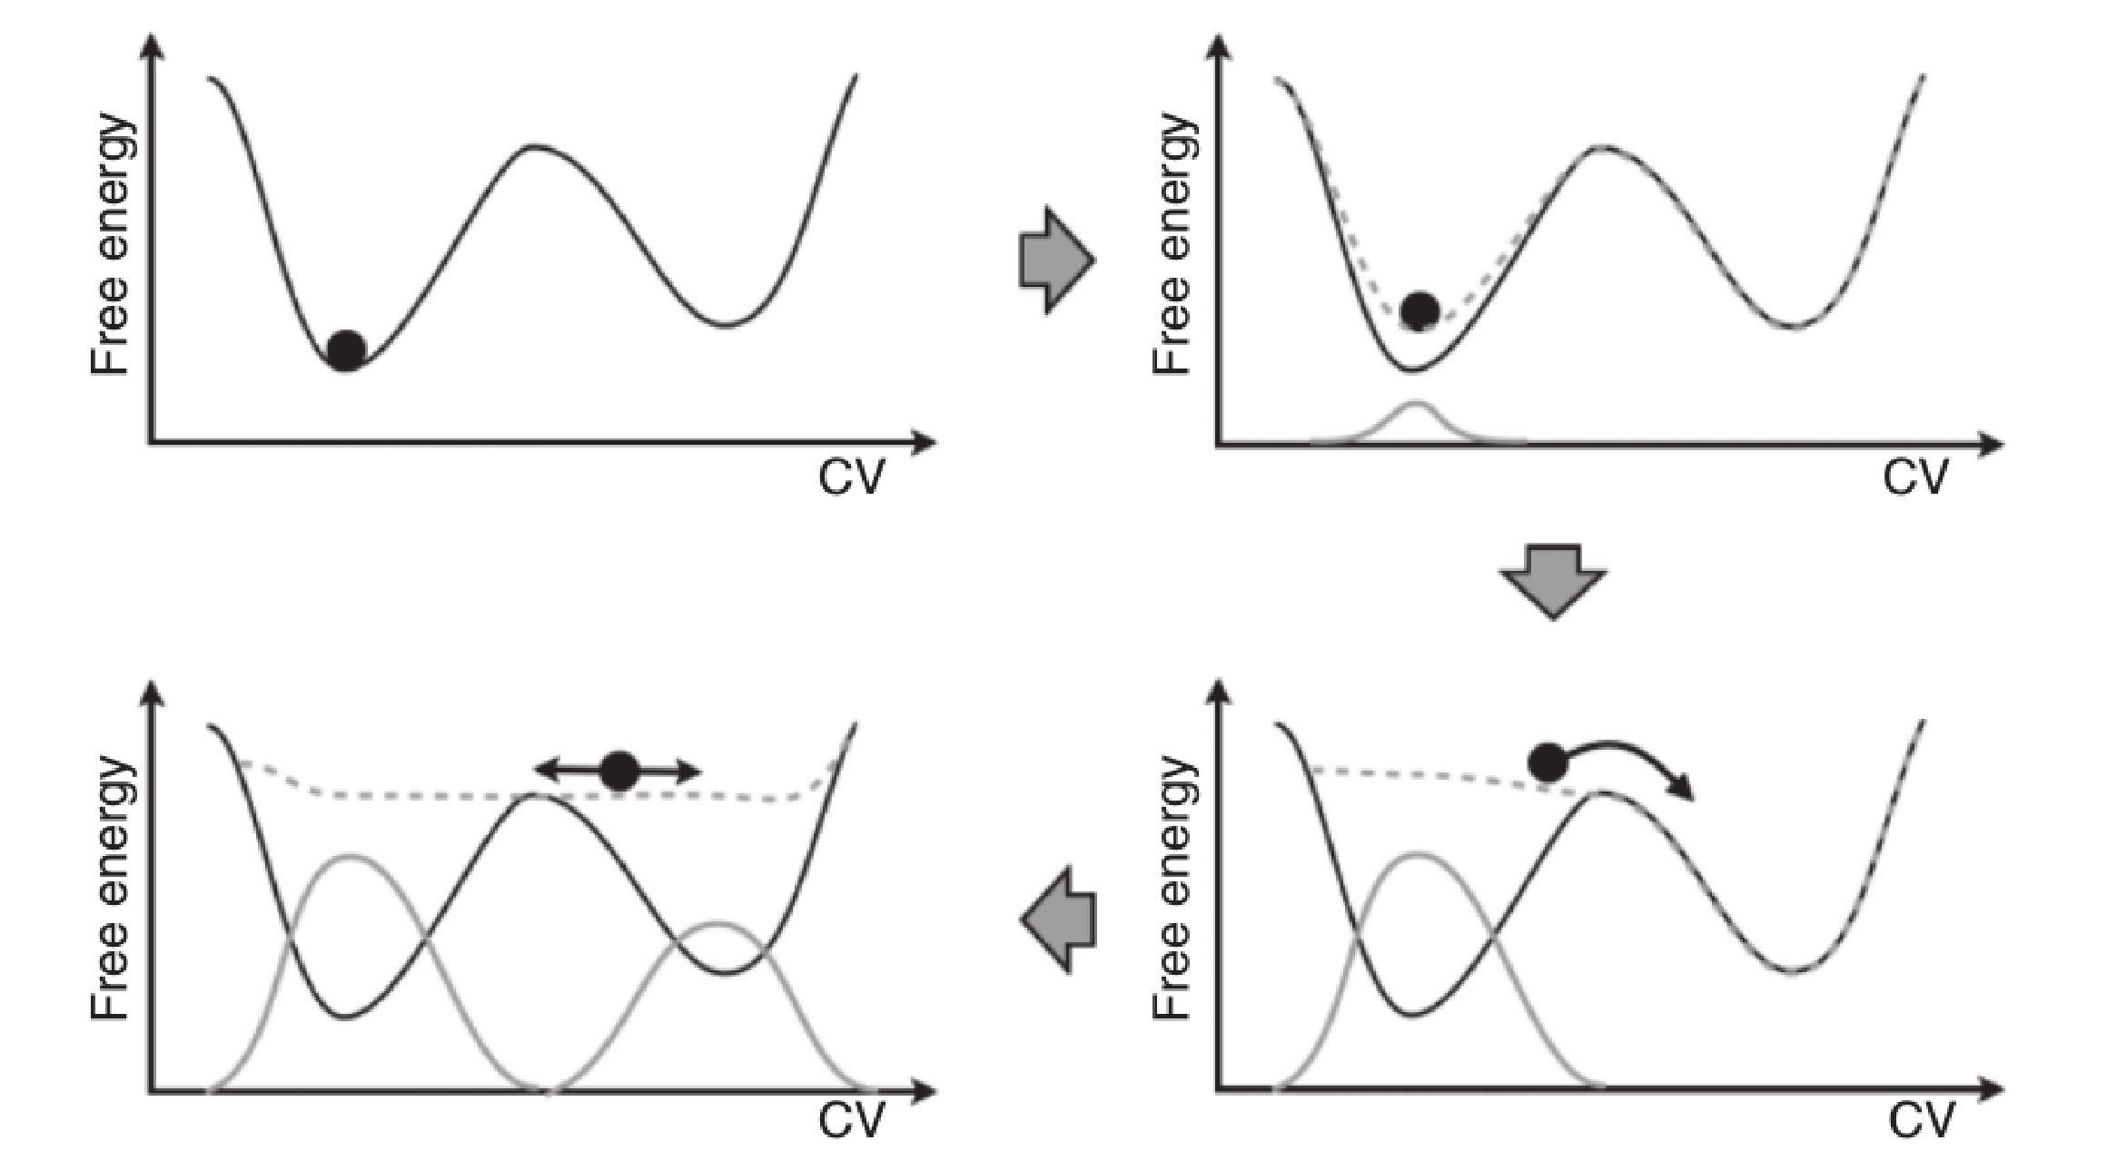
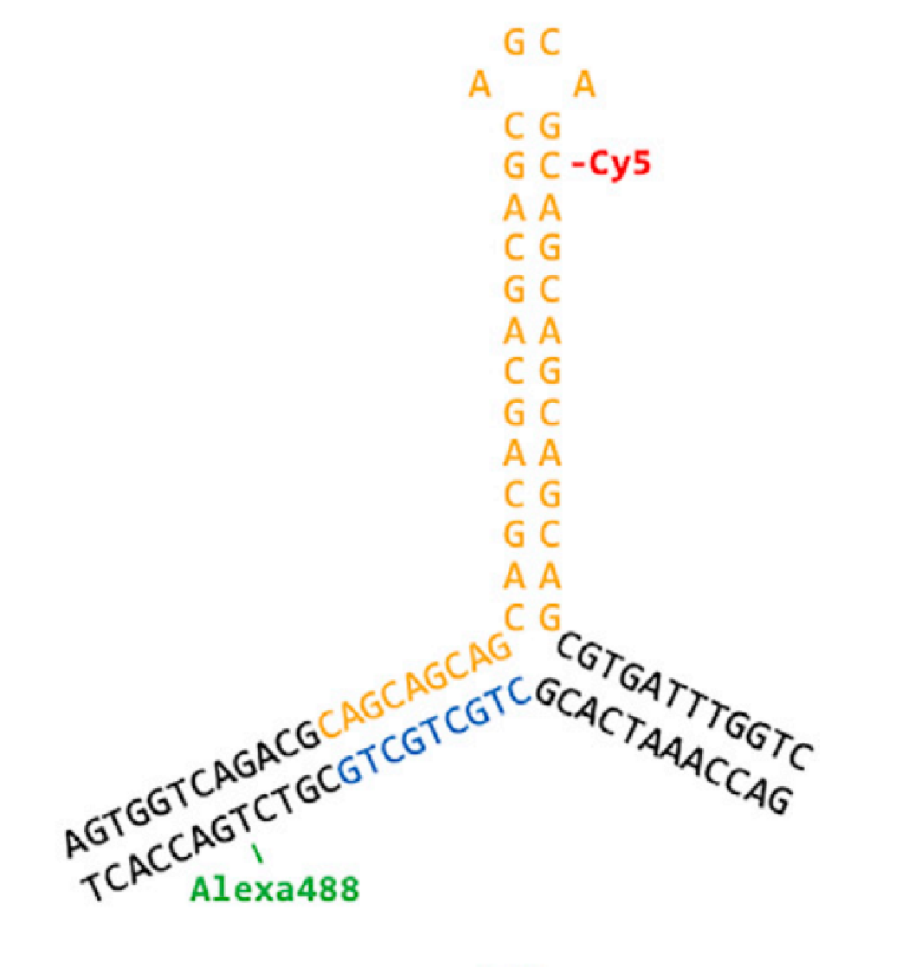
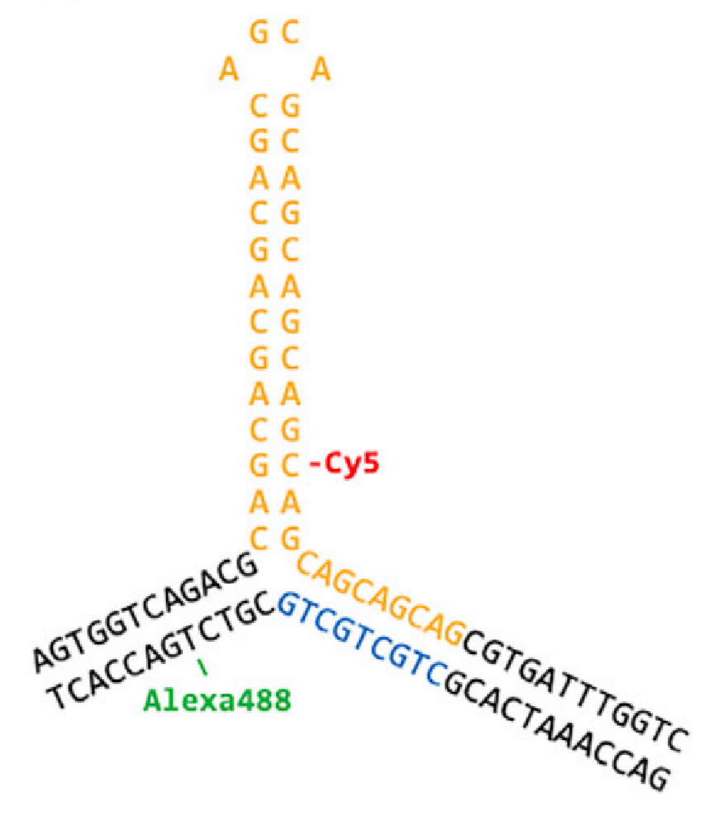
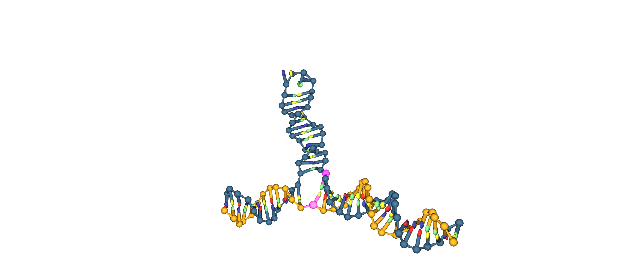
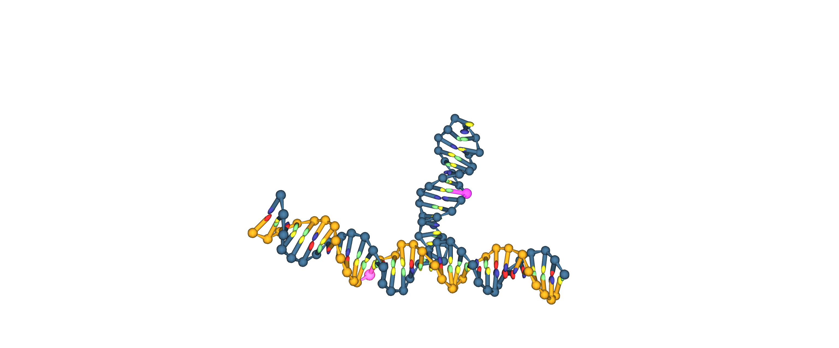
State Sampling
H | Enthalpy (U + pV)
T | System Temperature
S | Entropy
Maximum amount of work that a thermodynamic system can perform at constant temperature
G = H − TS
Reminder | Free Energy
Multiple Local Minima = Difficult to sample using conventional MD
?

Slide 6
Well-Tempered to Transition-Tempered MetaD
Principle of Metadynamics
WTMetaD
Reduces HILLS via exp decay
HILLS only time-dependant
Imprecise FES Convergence
TTMetaD
Reduces HILLS based on FES and CV
HILLS not time-dependant
Complete Sampling of FES
Apply and Record Gaussian Energy Packets (HILLS) -> Forces System into Rare Energy States
-> Allows for Complete Exploration of the Free Energy Landscape
*
*Figure From: Bussi and Branduardi. Free-energy calculations with metadynamics: Theory and practice. pages 1–49, 05 2015

Slide 7
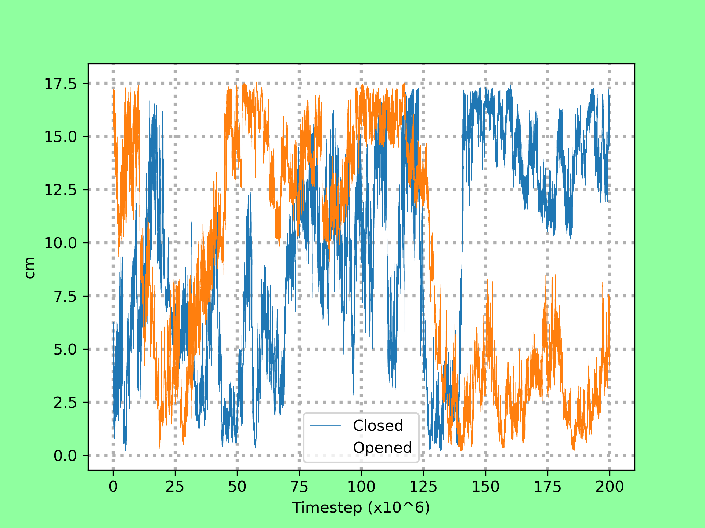
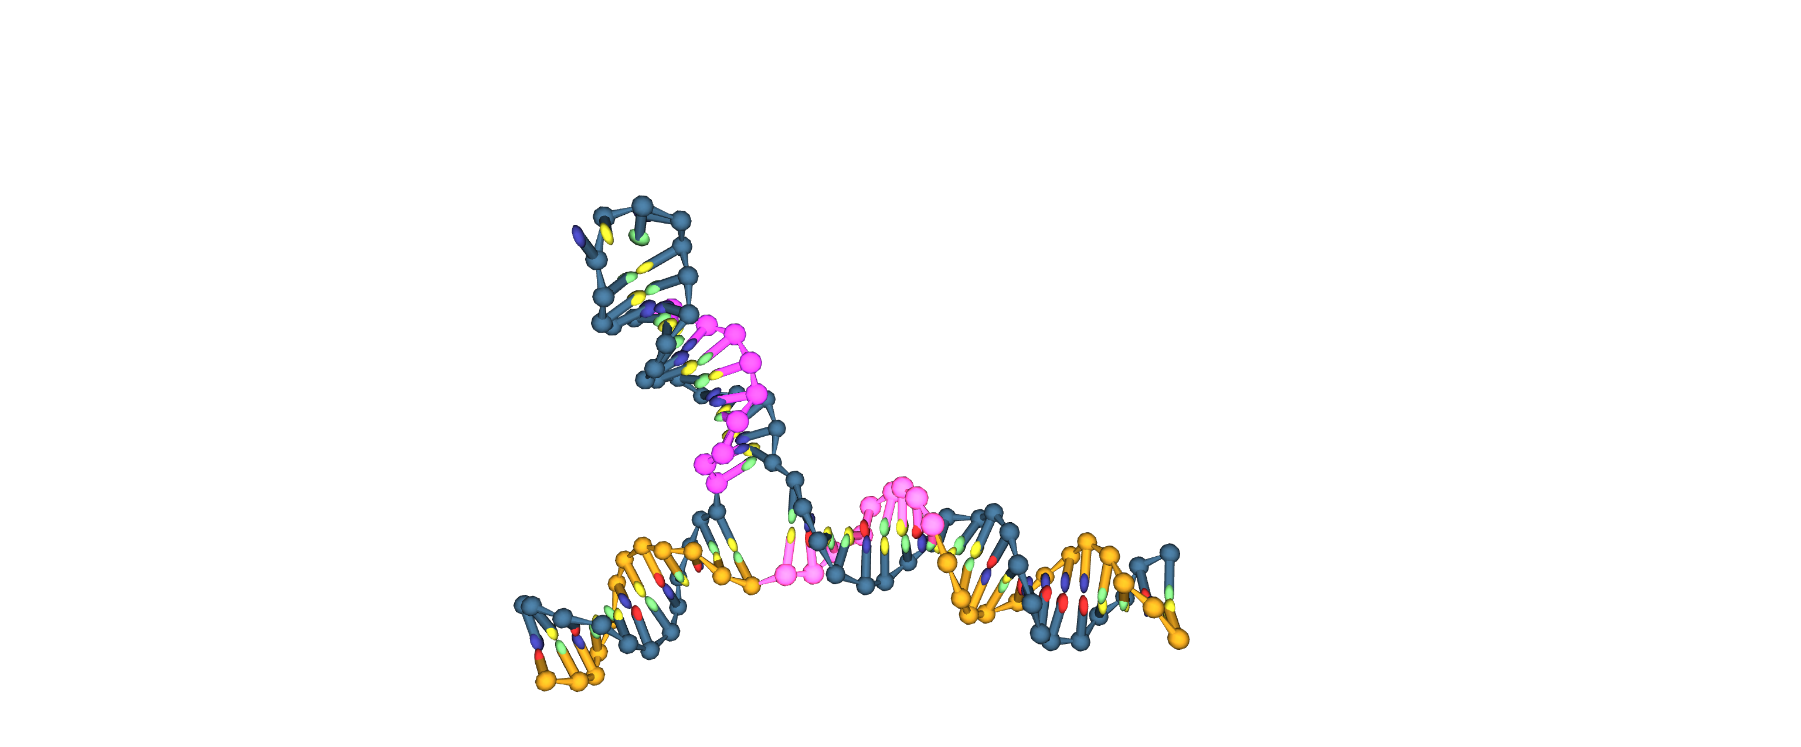
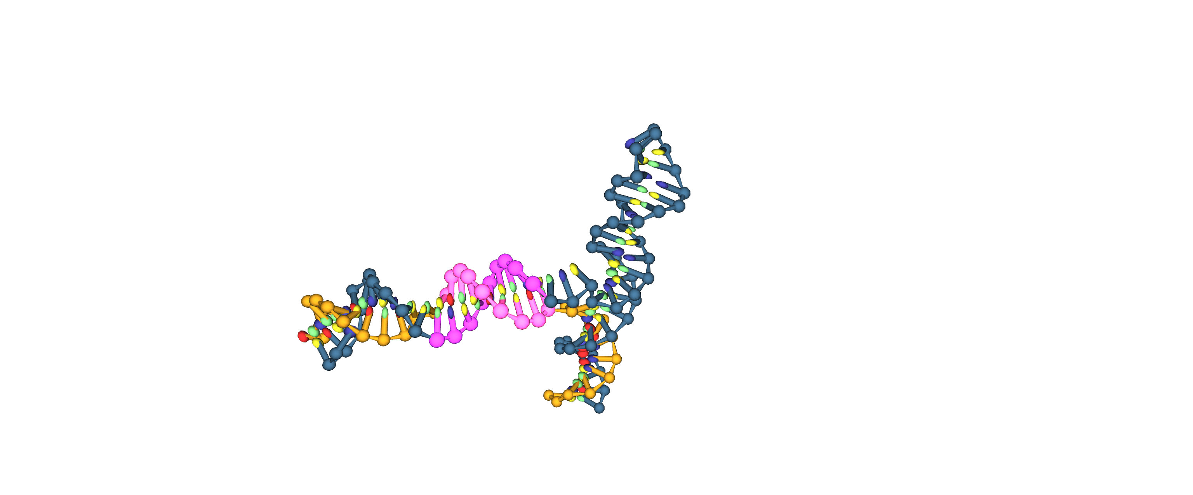
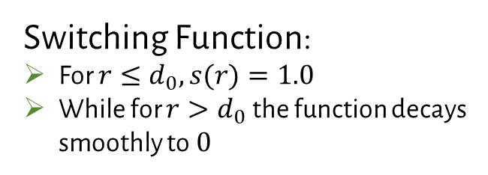
Contact Maps and Collective Variables
Contact Maps:
Calculate distances between a number of pairs of atoms
Transform each distance by a switching function (outputs CVs)
Switching Function:
For $r≤d_{0},s(r)=1.0$
While for $r>d_{0}$the function decays smoothly to 0
1 CV ≈ 1 Base Pair
Collective Variables (CV)
A
B
Denature
Hybridise
Timestep = 0
Timestep = 188M
A
B
Documentation | https://www.plumed.org/doc-v2.7/user-doc/html/_c_o_n_t_a_c_t_m_a_p.html

Slide 8
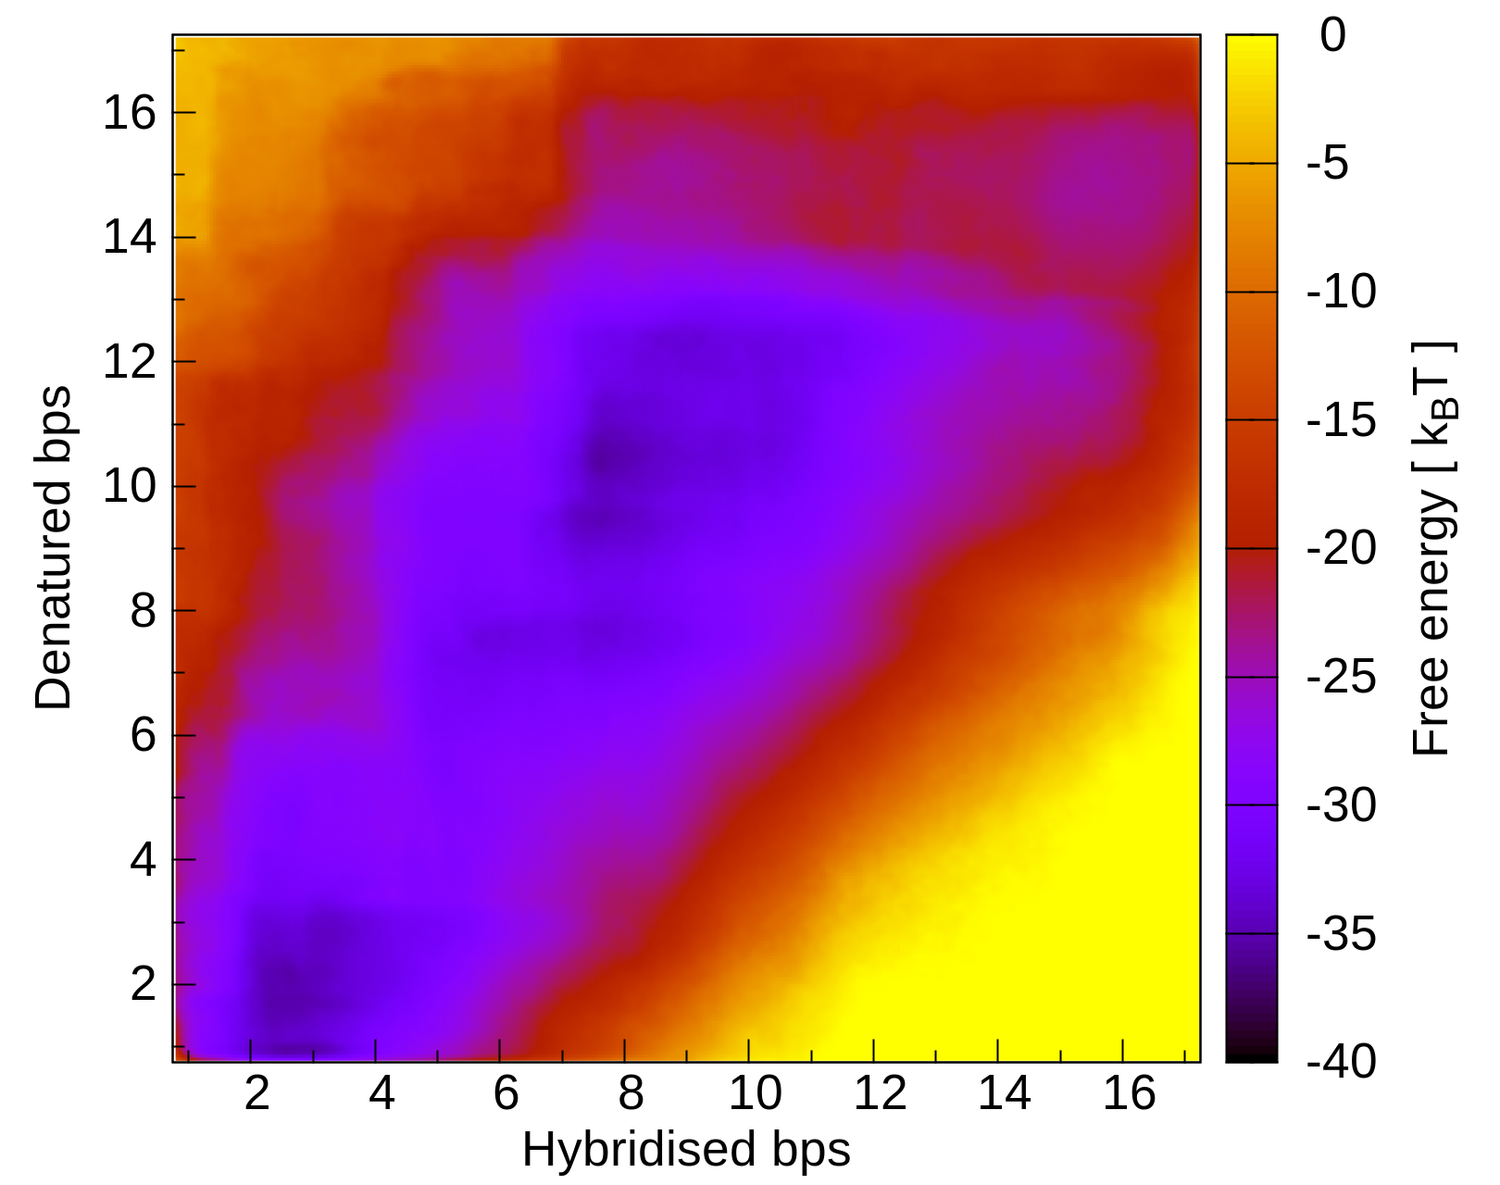
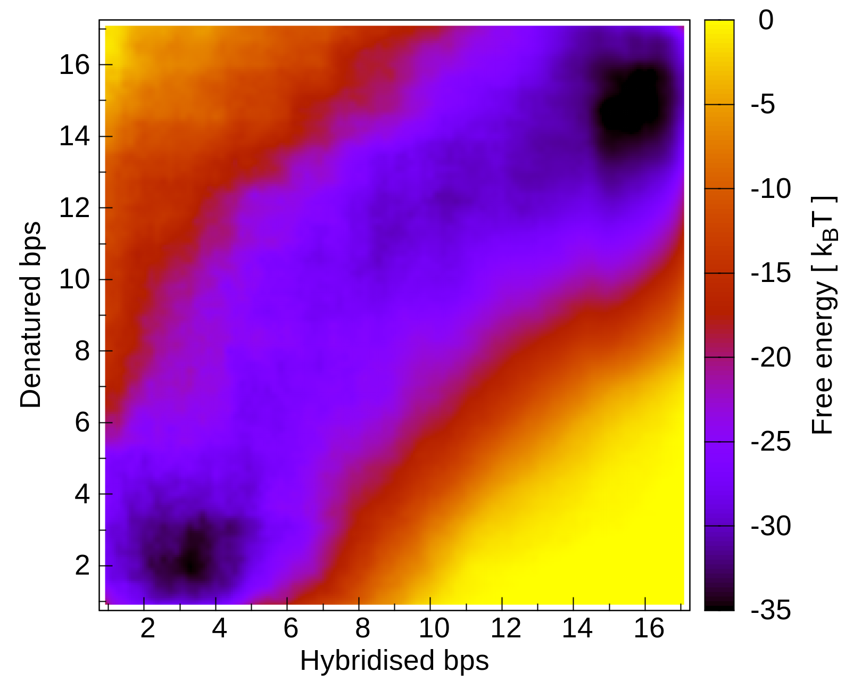
Free Energy Landscapes
Initial State = A
Final State = B
Initial State = A
Final State = B
B?
B
B?
A
A
WTMetaD, CTG_10
Initial State well-defined, but Final State lacks definition -> not yet fully converged
TTMetaD, CTG_10
Both Initial and Final State Well-Defined
Clear Transitional Mechanics (Path -->)

Slide 9
Conclusion and Remaining Work
TTMetaD over WTMetaD for Hairpin Migration Simulations:
Removes Dependence on Tuneable Parameters,
Faster Convergence with Greater Accuracy.
CG-Modelling matching Experimental Findings*
Results so far for CTG/CAG_10
CAG_40 and CTG_30 ?
A Few Useful Links:
https://www.lammps.org/ | https://docs.lammps.org/Packages_details.html#pkg-cg-dna
https://dna.physics.ox.ac.uk/index.php/Main_Page | https://www.plumed.org/
.ppt here on my GitHub | https://github.com/lrussell676/Public_Yr_5_Files
*Bianco, Hu, Henrich, Magennis. Biophysical Reports, Volume 2, Issue 3, 2022, 100070, ISSN 2667-0747, https://doi.org/10.1016/j.bpr.2022.100070.

Slide 10
X THE PLACE OF USEFUL LEARNING

